Slide 1
Introduction to Machine Learning and Data Mining (Học máy và Khai phá dữ liệu)
Khoat Than
School of Information and Communication Technology
Hanoi University of Science and Technology

Slide 2
Contents of the course
Introduction to Machine Learning & Data Mining
Supervised learning
Decision tree & Random forest
Unsupervised learning
Practical advice

Slide 3

1. Decision tree
Decision tree
To represent a function by using a tree.
Each decision tree can be interpreted as a set of rules of the form: IF-THEN
Decision trees have been used in many practical applications.

Slide 4
Examples of a decision tree (1)
“sport”?
is present
is absent
“player”?
“Music”?
is present
is absent
is present
is absent
Interested
Uninterested
Interested
“My God”?
is present
is absent
Interested
Uninterested
(…,“sport”,…,“player”,…) → Interested
(…,“My God”,…) → Interested
(…,“sport”,…) → Uninterested

Slide 5
Examples of a decision tree (2)
Outlook=?
Sunny
Rain
Overcast
Humidity=?
Yes
Wind=?
High
Normal
Strong
Weak
No
Yes
No
Yes
(Outlook=Overcast, Temperature=Hot, Humidity=High, Wind=Weak) → Yes
(Outlook=Rain, Temperature=Mild, Humidity=High, Wind=Strong) → No
(Outlook=Sunny, Temperature=Hot, Humidity=High, Wind=Strong) → No

Slide 6
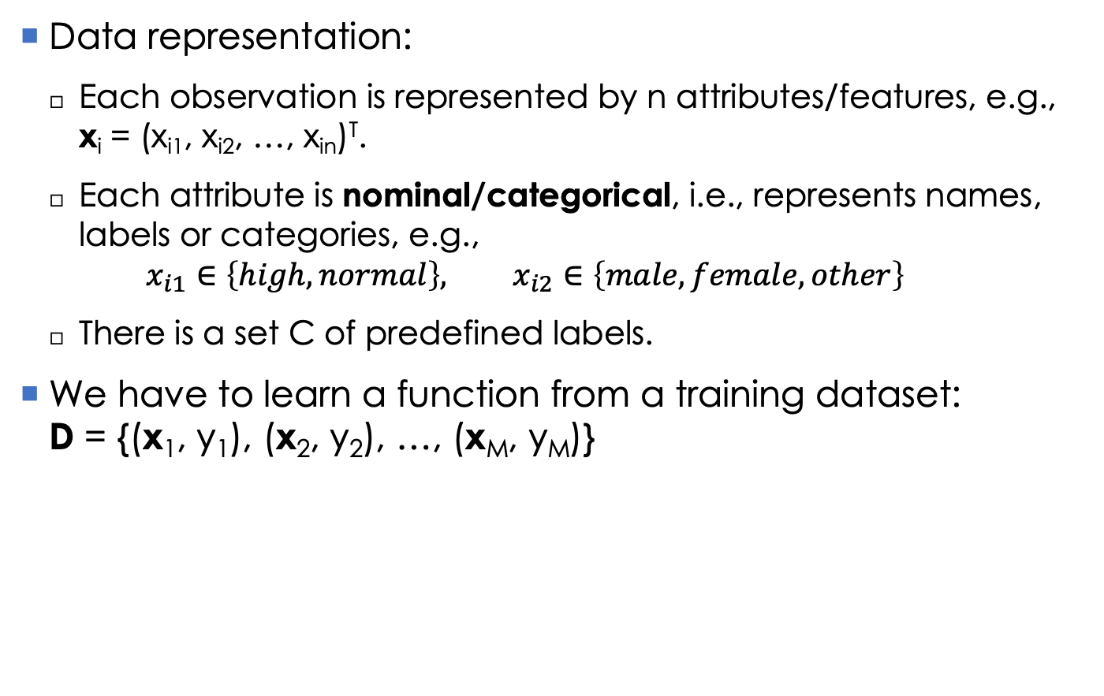
Classification problem
Data representation:
Each observation is represented by n attributes/features, e.g., x_{i} = (x_{i1}, x_{i2}, …, x_{in})^{T}.
Each attribute is nominal/categorical, i.e., represents names, labels or categories, e.g., $x_{i1}∈\left\{high, normal\right\}, x_{i2}∈\left\{male, female,other\right\}$
There is a set C of predefined labels.
We have to learn a function from a training dataset: D = {(x₁, y₁), (x₂, y₂), …, (x_{M}, y_{M})}

Slide 7
Tree representation (1)
Each internal node represents an attribute for testing the incoming data.
Each branch/subtree of a node corresponds to a value of the attribute of that node.
Each leaf node represents a class label.
Once a tree has been learned, we can predict the label for a new instance by using its attributes to travel from the root downto a leaf.
The label of the leaf will be used to assign to the new instance.

Slide 8
Tree representation (2)
Each path from the root to a leaf is a conjunction/AND of the attribute tests.
A decision tree itself is a disjunction/OR of those conjunctions.
Outlook=?
Sunny
Rain
Overcast
Humidity=?
Yes
Wind=?
High
Normal
Strong
Weak
No
Yes
No
Yes

Slide 9
Representation by a disjunction
“sport”?
is present
is absent
“player”?
“Music”?
is present
is absent
is present
is absent
Interested
Uninterested
Interested
“My God”?
is present
is absent
Interested
Uninterested
[(“sport” is present) ∧ (“player” is present)] ∨
[(“sport” is absent) ∧ (“Music” is present)] ∨
[(“sport” is absent) ∧ (“Music” is absent) ∧ (“My God” is present)]

Slide 10
2. Learning a decision tree by ID3
ID3 (Iterative Dichotomiser 3) is a greedy algorithm which was proposed by Ross Quinlan in 1986.
It uses the top-down scheme.
At each node N, select a test attribute A which can help us best do classification for the data in N.
Generate a branch for each value of A, and then separate the data into its branches accordingly.
Grow the tree until:
It classifies correctly all the training data; or
All the attributes are used.
Note: each attribute can only appear at most once in any path of the tree.

Slide 11
The ID3 algorithm
ID3_alg(Training_Set, Class_Labels, Attributes)
Generate the Root of the tree
If all of Training_Set belong to class c, then Return Root as leaf with label c
If Attributes is empty, then Return Root as leaf with label c = Majority_Class_Label(Training_Set)
A ← a set of Attributes that are best discriminative for Training_Set
Let A be the test attributes of Root
For each value v of A
Generate a branch of Root which corresponds with v.
Determine Training_Set_{v} = { x in Training_Set | x_{A} = v}
If (Training_Set_{v} is empty) Then
Generate a leaf with class label c = Majority_Class_Label(Training_Set)
Else Generate a subtree by ID3_alg(Training_Set_{v}, Class_Labels, Attributes \{A})
Return Root

Slide 12
How to choose the test attributes?
At each node, how can we choose a set of test attributes?
These attributes should be discriminative, i.e., can help us classify well the data inside that node.
How to know an attribute to be discriminative?
Ex: assuming 2 classes in the data, which of A₁ and A₂ should be selected as the test attribute?
Information gain can help.
A₁=?
(c₁: 35, c₂: 25)
A₂=?
(c₁: 35, c₂: 25)
v₁₁
v₁₃
v₂₁
v₂₂
v₁₂
c₁: 21
c₂: 9
c₁: 5
c₂: 5
c₁: 9
c₂: 11
c₁: 27
c₂: 6
c₁: 8
c₂: 19

Slide 13
Information gain: entropy
Entropy measures the impurity/inhomogeneity of a set.
Entropy of a set S with c classes can be defined as:
Where p_{i} is the proportion of instances with class label i in S; and 0.log₂0 = 0 as a convention; p₁+p₂+…+p_{c} = 1
For 2 classes: entropy(S) = - p₁log₂p₁ - p₂log₂p₂
Meanings of entropy in Information Theory:
Entropy shows the number of bits on average to encode a class of S.
Entropy of a message measures the average amount of information contained in that message.
Entropy of a random variable x measures the unpredictability of x.

Slide 14
Information gain: entropy example
S consists of 14 examples for which 9 belong to class c₁ and 5 belong to class c₂.
So the entropy of S is:
Entropy(S) = -(9/14).log₂(9/14) -(5/14).log₂(5/14) ≈ 0.94
Entropy = 0 if all examples in S have the same label.
Entropy = 1 if the two classes in S are equal in size.
Otherwise, entropy will always belong to (0, 1).
Entropy(S)
1
0.5
0
0.5
1
p₁

Slide 15
Information gain
Information gain of an attribute in S:
Measures the reduction of entropy if we divide S into subsets according to that attribute.
Information gain of attribute A in S is defined as:
Where Values(A) is the set of all values of A, and S_{v} = {x | x in S, and x_{a} = v}
The second term in Gain(S,A) measures the information remained when S is divided into subsets according to the values of A.
Meaning of Gain(S,A): the average amount of information is lost when dividing S according to A.

Slide 16
Information gain: example (1)
A set S of observations about a person playing tennis.
Day
Outlook
Temperature
Humidity
Wind
Play Tennis
D1
Sunny
Hot
High
Weak
No
D2
Sunny
Hot
High
Strong
No
D3
Overcast
Hot
High
Weak
Yes
D4
Rain
Mild
High
Weak
Yes
D5
Rain
Cool
Normal
Weak
Yes
D6
Rain
Cool
Normal
Strong
No
D7
Overcast
Cool
Normal
Strong
Yes
D8
Sunny
Mild
High
Weak
No
D9
Sunny
Cool
Normal
Weak
Yes
D10
Rain
Mild
Normal
Weak
Yes
D11
Sunny
Mild
Normal
Strong
Yes
D12
Overcast
Mild
High
Strong
Yes
D13
Overcast
Hot
Normal
Weak
Yes
D14
Rain
Mild
High
Strong
No
[Mitchell, 1997]

Slide 17
Information gain: example (2)
What is Gain(S, Wind)?
Wind has two values: Strong & Weak
S = {9 examples with label Yes, 5 examples with label No}
S_{Weak} = {6 examples with label Yes and 2 examples with label No, having Wind=Weak}
S_{Strong} = {3 examples with label Yes, 3 examples with label No, having Wind=Strong}
So:

Slide 18
ID3: example (1)
At the root, which one of {Outlook, Temperature, Humidity, Wind} should be the test attribute?
Gain(S, Outlook) = ... = 0.246
Gain(S, Temperature) = ... = 0.029
Gain(S, Humidity) = ... = 0.151
Gain(S, Wind) = ... = 0.048
So, Outlook is selected as the test attribute.
Outlook=?
S={9+, 5-}
Sunny
Overcast
Rain
Node1
Yes
Node2
S_{Sunny}={2+, 3-}
S_{Overcast}={4+, 0-}
S_{Rain}={3+, 2-}

Slide 19
ID3: example (2)
At Node1, which one of {Temperature, Humidity, Wind} should be the test attribute?
Note: Outlook is left out
Gain(S_{Sunny}, Wind) = ... = 0.019
Gain(S_{Sunny}, Temperature) =...= 0.57
Gain(S_{Sunny}, Humidity) = ... = 0.97
So, Humidity is selected to divide Node1.
Outlook=?
S={9+, 5-}
Sunny
S_{Sunny}= {2+, 3-}
Overcast
Rain
Humidity=?
Yes
Node2
S_{Overcast}={4+, 0-}
S_{Rain}= {3+, 2-}
High
Normal
Node3
Node4
S_{High}= {0+, 3-}
S_{Normal}= {2+, 0-}

Slide 20
ID3: searching scheme (1)
ID3 searches for a tree that fits well with the training data.
By growing the tree gradually.
Information Gain decides the search direction of ID3.
ID3 just searches for only one tree.
ID3 never backtracks, as a consequence:
It can find a local optimal solution/tree.
Once an attribute has been selected, ID3 never rethinks of this choice.

Slide 21
ID3: searching scheme (2)
For a training dataset, there might be many trees that fit well with it.
Which tree will be selected by ID3?
Outlook=?
Outlook=?
Sunny
Overcast
Rain
Sunny
Overcast
Rain
Humidity=?
Yes
Wind=?
Temperature=?
Yes
Wind=?
High
Normal
Strong
Weak
Hot
Cool
Mild
Strong
Weak
No
Yes
No
Yes
No
Yes
Humidity=?
No
Yes
High
Normal
No
Yes

Slide 22
ID3: searching scheme (3)
ID3 selects the first tree that fits the training data,
Because it never reconsiders its choices when growing a tree.
So, the searching scheme of ID3:
Prefers simple trees.
Prefers trees in which the attributes with higher information gain will be placed closer to the roots.

Slide 23
3. Some issues of ID3
The learnt trees may overfit the training data.
How to work with real attributes?
Many applications have real inputs.
Is there any better measure than information gain?
How to deal with missing values?
Missing-value is an inherent problem in many practical applications.
How to enclose the cost of attributes in ID3?

Slide 24
Overfitting in ID3 (1)
Is it good if a tree fits well the training data?
When there are some noises/errors in examples:
May results in misguided directions for searching a tree.
May results in more complex trees.
(due to errors in data)
Outlook=?
Outlook=?
Sunny
Overcast
Rain
Sunny
Overcast
Rain
Humidity=?
Yes
Wind=?
Humidity=?
Yes
Wind=?
High
Normal
Strong
Weak
High
Normal
Strong
Weak
No
Yes
No
Yes
No
…continue growing
No
Yes

Slide 25
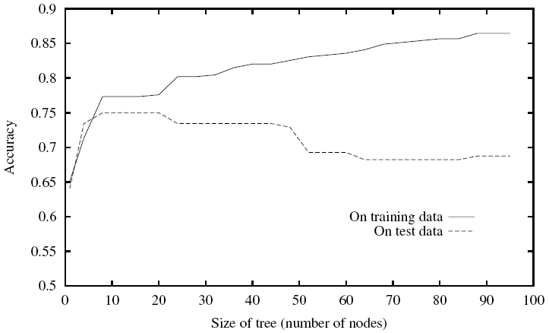
Overfitting in ID3 (2)
An example: continuing to grow the tree can improve the accuracy on the training data, but perform badly on the test data.
[Mitchell, 1997]

Slide 26
Overfitting: solutions
2 solutions:
Stop learning early: prevent the tree before it fits the training data perfectly.
Prune the full tree: grow the tree to its full size, and then post prune the tree.
It is hard to decide when to stop learning.
Post-pruning the tree empirically results in better performance. But
How to decide the good size of a tree?
When to stop pruning?
We can use a validation set to do pruning, such as, reduced-error pruning, and rule-post pruning.

Slide 27
Reduced-error pruning
Set a validation dataset T_{valid} aside
A node will be pruned if the error on T_{valid} does not deteriorate significantly.
Pruning a node consists of:
Removal of its subtrees.
Changing that node to be a leaf.
Labeling this new leaf by using majority of the classes of the training data in that node.
Repeat pruning:
For any node that improves/keeps the performance on T_{valid}.
Until further pruning causes significant errors on T_{valid}.

Slide 28
ID3: attribute selection
Information gain:
Prefers the attribute that has more unique values.
Attributes with more unique values will be placed closer to the root than the other attribute.
We can use some other measures, such as Gain Ratio

Slide 29
ID3: missing or real values
How to work with real attributes?
Real attributes/features are popular in practice.
One way is to discretization, i.e., transforming a real attribute into a discrete one by dividing the domain of that attribute into a set of intervals. Ex: [0, 1] → {[0, 0.25); [0.25, 0.5); [0.5, 0.75); [0.75, 1]}
How to deal with missing values?
Missing values are inherent in practical applications.
An observation x may not have a value x_{A}.
Solution 1: fill in x_{A} as the most popular value of A in the training data.
Solution 2: fill in x_{A} as the most popular value of A in the training data which belong to the same class with x.

Slide 30
4. Decision trees for regression
We can easily design a decision tree for the regression problem.
Suggested modification of ID3:
Replace information gain by another measure to select test attributes for each node.
At each leaf, save all the training examples of the leaf.
Prediction for a new z:
Traverse the tree from the root to a leaf according to the attributes of z.
Denote L the leaf to which z traverses, D(L) be the set of observations inside L, with size k.
Predict the label as:

Slide 31
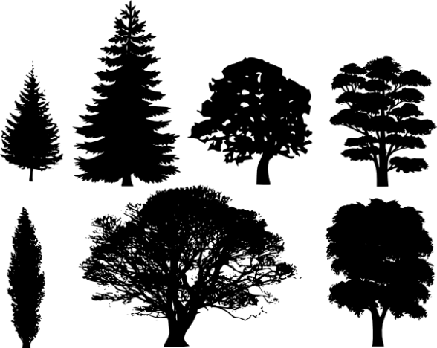
5. Random forests
Random forests (RF) is a method by Leo Breiman (2001) for both classification and regression.
Main idea: prediction is based on combination of many decision trees, by taking the average of all individual predictions.
Each tree in RF is simple but random.
Each tree is grown differently, depending on the choices of the attributes and training data.

Slide 32
5. Random forests
RF currently is one of the most popular and accurate methods [Fernández-Delgado et al., 2014]
It is also very general.
RF can be implemented easily and efficiently.
It can work with problems of very high dimensions, without overfitting ☺
However, little is known about its theoretical properties ☹

Slide 33
5. RF: three basic ingredients
Randomization and no pruning:
For each tree and at each node, we select randomly a subset of attributes.
Find the best split, and then grow appropriate subtrees.
Every tree will be grown to its largest size without pruning.
Combination: each prediction later is made by taking the average of all predictions of individual trees.
Bagging: the training set for each tree is generated by sampling (with replacement) from the original data.

Slide 34
5. RF: algorithm
Input: training data D
Learning: grow K trees as follows
Generate a training set D_{i} by sampling with replacement from D.
Learn the i^{th} tree from D_{i}:
At each node:
Select randomly a subset S of attributes.
Split the node into subtrees according to S.
Grow this tree upto its largest size without pruning.
Prediction: taking the average of all predictions from the individual trees.

Slide 35
5. RF: practical performance
RF is extensively compared with other methods
By Fernández-Delgado et al. (2014).
Using 55 different problems.
Using average accuracy (μ^{P}) as a measure.

Slide 36
References
L. Breiman. Random forests. Machine learning, 45(1), 5-32, 2001.
Manuel Fernández-Delgado, Eva Cernadas, Senén Barro, Dinani Amorim. Do we Need Hundreds of Classifiers to Solve Real World Classification Problems? Journal of Machine Learning Research, 15(Oct):3133−3181, 2014.
T. M. Mitchell. Machine Learning. McGraw-Hill, 1997.
M. Nunez. The use of background knowledge in decision tree induction. Machine Learning, 6(3): 231-250, 1991.
Quinlan, J. R. Induction of Decision Trees. Mach. Learn. 1, 1 (Mar. 1986), 81-106, 1986
Trevor Hastie, Robert Tibshirani, Jerome Friedman. The Elements of Statistical Learning. Springer, 2009.
Sebastiani, F. (2002). Machine learning in automated text categorization. ACM computing surveys (CSUR), 34(1), 1-47.

